Slide 1

AUTOMATED HR
FYP Defense Presentation By BSCS-F24-020
ENROLLMENT NUMER | NAME
03-134212-066 | Muhammad Mughees Ahmed
03-134212-067 | Muhammad Owaim
03-134212-096 | Wajeeha Khan
Supervisor : Muhammad Mudassar

Slide 2
CLO Mapping
CLO | PLO | Description
CLO1 | PLO3:Problem Analysis | Analyze the given problem to propose a computing-based solution.
CLO2 | PLO4:Design and Development of Solutions | Design and develop computing solutions to complex computing problems.
CLO3 | PLO5:Modern Tool Usage | Demonstrate the ability to use modern tools to solve the given problem.
CLO4 | PLO6:Individual and Team Work | Demonstrate the ability to work effectively as an individual and a team member.
CLO5 | PLO10:Life Long Learning | Understand the significance of broader aspects of innovation, potential legal implications, and development.
CLO6 | PLO7:Communication | Demonstrate effective skills in verbal and written communication during presentations, discussions, and reports.

Slide 3

ABSTRACT
The Automated HR System leverages NLP, machine learning, and real-time analytics to streamline recruitment, scoring candidates based on relevance and automating communication. It enhances hiring quality, reduces bias, and equips HR with predictive insights for strategic workforce planning.

Slide 4
OBJECTIVE
AI-based resume screening using ML algorithms
Filters candidates by job description, Category
Eliminates manual screening and reduces errors
Minimizes HR workload and improves efficiency
Enhances decision-making and hiring accuracy
Answers FAQs and guides new hires on policies
Chatbot for onboarding support

Slide 5

SCOPE
This AI-powered HR platform streamlines recruitment by using NLP and ML to rank resumes, onboard employees via smart chatbots, and automate record management. It enhances decision-making with predictive analytics and scalable, modular architecture for strategic workforce planning. No such FYP attempted in BULC.

Slide 6
PROBLEM DESCRIPTION
Traditional recruitment is time-consuming and error-prone, with HR burdened by high application volumes and repetitive queries. Manual onboarding and record management lack efficiency, while limited data visibility hinders strategic workforce planning.

Slide 7
PROPOSED SOLUTION
AI/ML-powered resume screening with NLP and supervised learning
Smart chatbot for 24/7 support and automated onboarding workflows
Admin dashboard with full CRUD capabilities and audit logging
Data-driven dashboards for insights, predictive analytics, and planning
Cloud-native, scalable platform with modular AI services

Slide 8
ASSUMPTION FOR REFINING SCOPE BOUNDARY
Resumes and job descriptions are in digital text formats (DOCX)
Organizational HR policies and FAQs are provided for chatbot training
Existing HR systems can integrate or coexist with this platform
Stakeholders agree on role-based access and data privacy protocols
Predictive models are trained on organization-specific historical data

Slide 9
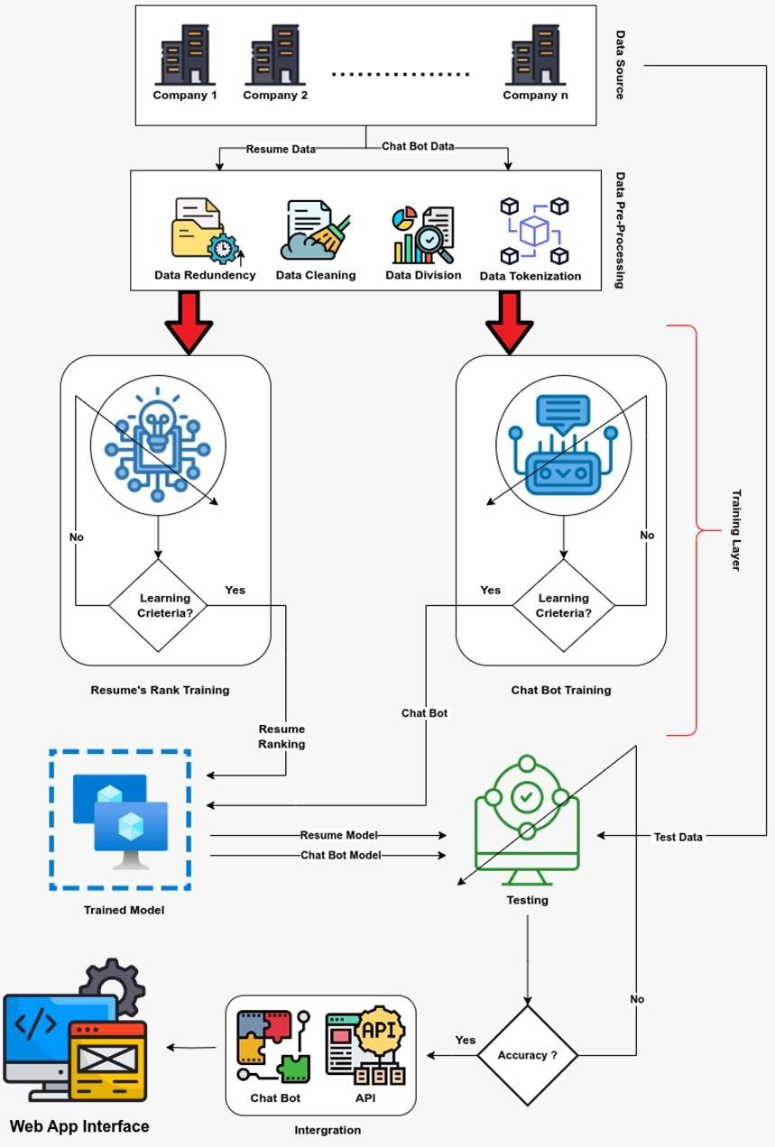
METHODOLOGY

Slide 10




PHASES
Data Cleaning
Model Training
Web App Integration

Slide 11

DATA CLEANING
Eliminate null values for data reliability
1
Remove duplicate entries to reduce bias
2
Apply tokenization to break text into meaningful units
3
Result: Clean, structured, high-quality data for accurate AI model training.
4

Slide 12
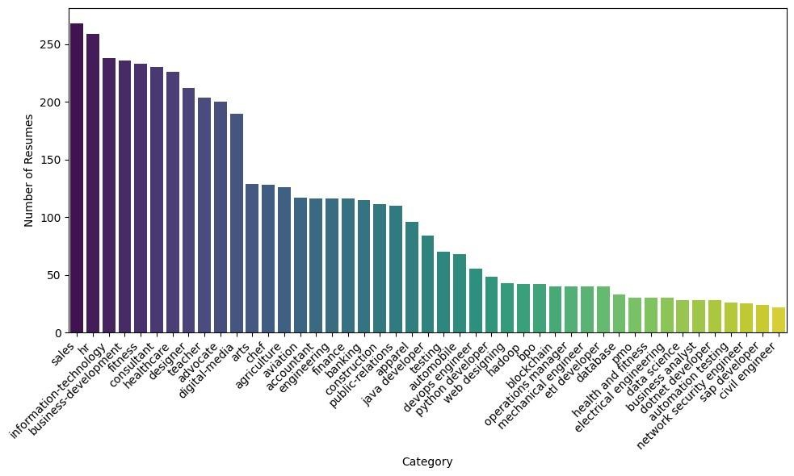
BAR CHART (Distribution of resumes by category)

Slide 13
MODEL TRAINING
ML model ranks resumes based on Job Description & Category
Trained on historical resume data using NLP to extract relevant features
Model is iteratively refined for improved ranking accuracy

Slide 14

WEB APP INTEGRATION
ML models integrated into HR web app
Resume ranking model automates shortlisting based Job Description & Category
Frees HR to focus on interviews and communication instead of manual filtering
Chatbot model provides 24/7 employee support through real-time responses
Assists with FAQs, application guidance, and HR policy info
AI integration improves accuracy, efficiency, and decision-making

Slide 15
DELIVERABLES
Automated resume shortlisting system
NLP-enabled chatbot for HR-related queries
Streamlined and error-free hiring workflow
Time-saving automation tools

Slide 16
BENEFICIARIES
HR teams – faster applicant filtering
Job applicants – quick query resolution
New employees – smoother onboarding
Organizations – improved hiring efficiency

Slide 17
DATA DESCRIPTION
"Category" and "Resume" columns
NLP Preprocessing (cleaning, tokenization)
TF-IDF vectorization
Label Encoding
Final structured dataset
FEATURE EXTRACTION
Used for resume classification by job type
Used for resume classification by job type
Translates text into machine-readable features
Makes category labels usable for ML models
Enables resume screening, classification, matching

Slide 18
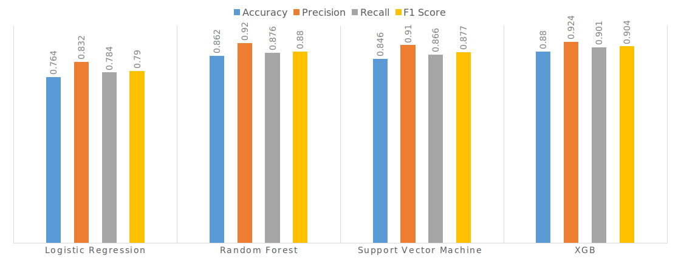
CLASSIFICATION RESULTS

Slide 19
CONCLUSION
The AI-powered recruitment platform leverages NLP, ML (e.g., XGB), and TF-IDF to automate resume screening, ranking, and onboarding, drastically reducing HR workload. With real-time chatbots and integrated workflows, it streamlines hiring into a fast, data-driven, end-to-end process.

Slide 20

RECOMMENDATION
To enhance performance, Different firms can use this project to enhance their productivity.
This reduces time and cost .Advanced resume-parsing APIs ensure enterprise-level adaptability and precision.

Slide 21


